Slide 1
Intermediate Software Craftsmanship
Brendan Enrick | @brendoneus
Jeff Valore | @CodingWithSpike

Slide 2
Advanced Practices
Behavior-Based Testing
Fake Objects
Mock Objects
Dependency Inversion
Injection
Onion Architecture

Slide 3
Behavior-Based Testing
Confirms system interacted with collaborators as expected
Given certain inputs, certain messages to collaborators were expected
There may be no returned state to inspect (e.g. void methods)

Slide 4
Dependencies and Interfaces
Dependencies are any constructs the system under test must work with to perform its function
Dependencies are transitive: If A depends on B and B depends on C, then A depends on C

Slide 5

Dependencies and Interfaces
An arch structure depends on every stone; the central keystone most of all.

Slide 6
Don’t Make Infrastructure Key Dependency
Presentation Layer
All dependencies point inward toward infrastructure
Business Layer
Unit Tests
Tests (and everything else) now depend on Infrastructure
Infrastructure
Data Access
Notes:
Naïve layered architecture

Slide 7
How can we fix this?
Limit number of dependencies
Invert and inject dependencies
Structure solution to make it difficult to depend on Infrastructure

Slide 8
Dependency Injection
Constructor Injection (my preferred)
Parameter Injection
Property Injection

Slide 9
Constructor Injection
All Dependencies declared in constructor
May be required, or may provide defaults
a.k.a “poor man’s dependency injection”
Each parameter is set to a private field
Follows Explicit Dependencies Principle

Slide 10
Parameter Injection
All Dependencies declared as method parameters
Useful for dependencies used by only one method
May result in long parameter lists

Slide 11
Property Injection
Expose dependencies as properties
Class may be in an invalid state between construction and setting of dependency properties
Use only when other forms of injection are not available (e.g. ASP.NET Web Forms)

Slide 12
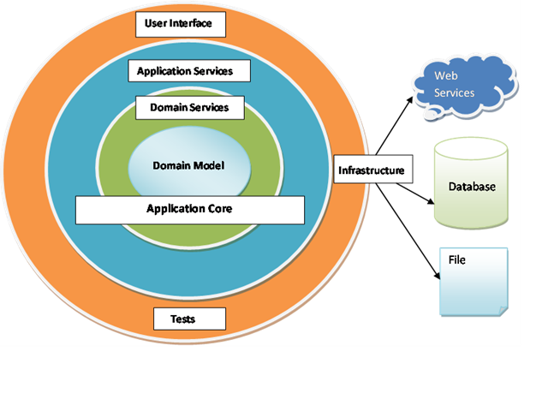
Onion Architecture aka Ports and Adapters
All dependencies point inward toward the core.

Slide 13
Infrastructure Depends on Core
Core does not depend on infrastructure
Core is very easy to test
Services and UI can limit dependencies on infrastructure
Can test with (integration tests) or without (unit tests) infrastructure

Slide 14
Using Fake Objects
When the real object is difficult to verify under test, create a fake object
Inherit from the real class
(better) Implement the necessary interface
Provide methods for verifying the fake object’s behavior under test
i.e. “WasThisMethodCalled” or “LastParameterReceived” properties/methods

Slide 15
What is Mocking?
Dynamic, runtime creation of fake objects
No need to hand-code the entire object
Mocking frameworks provide verification methods
Provide ways to specify object behavior
Typically via lambda expressions
Some commercial products can mock static types and other hard-to-test structures

Slide 16
State vs. Behavior Testing
State
Get initial values
Set some values
Call a method
Inspect returned value
Behavior
Verify methods were called
Verify correct arguments were passed
Notes:
You’ll frequently combine state and behavior tests in your test suites. Behavior tests are especially useful for testing methods that return or void and/or serve to orchestrate between collaborators.

Slide 17
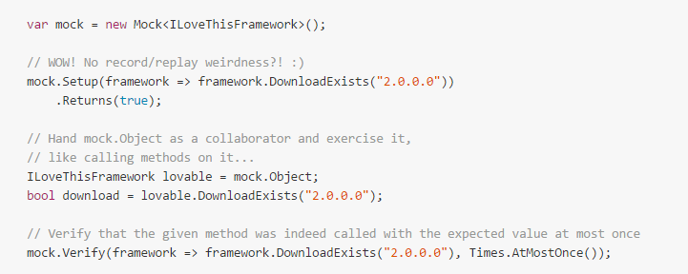
Moq Sample

Slide 18

Discuss

